Slide 1


Creating a Blue Economy:
Research and innovation partnerships to accelerate the development of ocean-related industries
Cristina Sousa, Oscarina Conceição & Margarida Fontes
This research was supported by a grant from FCT (PTDC/GES-OUT/30559/2017)

Slide 2
Aim
analyse the directions followed by the research and innovation activities performed by Portuguese organisations in the fields encompassed by the “Blue Economy”, to conduct a first assessment of the effectiveness of the national strategic orientations:
  identify the areas receiving greater attention – namely the relative importance of emerging areas vs. advances targeting established ones.
  map the positioning of different types of organisation in the developments taking place – stressing the role of new technology intensive firms (NTIFs).

Slide 3
Motivation
The “Blue Economy” has been identified as a driver of European growth, through the development of new competences and activities that enable a sustainable exploitation of ocean resources.
Strategies and policies were defined, both at EU and national level, targeting the broad variety of actors.
Research and innovation activities were regarded as key elements in these strategies, both those aiming at the revitalisation of established sectors and the development of emerging industries, as well as at a better understanding of the marine environment and the requirements for its preservation.

Slide 4
Blue Economy
EU’s Blue Economy definition encompasses all sectoral and cross-sectoral economic activities related to the oceans, seas and coasts, including those in the EU’s outermost regions and landlocked countries.
Namely it includes:
  Established sectors: Maritime transport; Coastal tourism; Marine living resources, extraction and commercialisation (fisheries, aquaculture; processing and distribution); Marine extraction of minerals, oil and gas; Ports, warehousing and water projects; Shipbuilding and repair.
  Emerging and innovative industries: Blue energy (offshore wind energy; ocean energy); Blue bio economy; Marine minerals; Desalination; Maritime defence.
  Natural capital and ecosystem services.

Slide 5
The Blue Economy: a policy-driven innovation system
EU level initiatives such as the definition of an Integrated Maritime Policy for the European Union and the Communication on Blue Growth, were subsequently translated to European policy instruments, namely in the scope of the Framework Programmes (FPs), and were highly influential in policy formulation at country level.
This was the case of Portugal that launched, in 2012, a revised National Ocean Strategy and Action Plan, whose model of development and areas of intervention were strongly influenced by the European framework.

Slide 6
The production of new scientific knowledge and the development of new technologies, products and services were seen as central to stimulate the creation of new industrial activities, to revitalise established industries and to tackle the problems associated with increased human activity in the ocean environment.
One of the goals of the national Action Plan was to increase the participation of companies in these activities in order to strengthen the industrial structure around the “Sea Economy”. This included the involvement of existing companies and also the creation of new ones exploiting emerging technologies, namely new technology intensive firms (NTIFs)

Slide 7
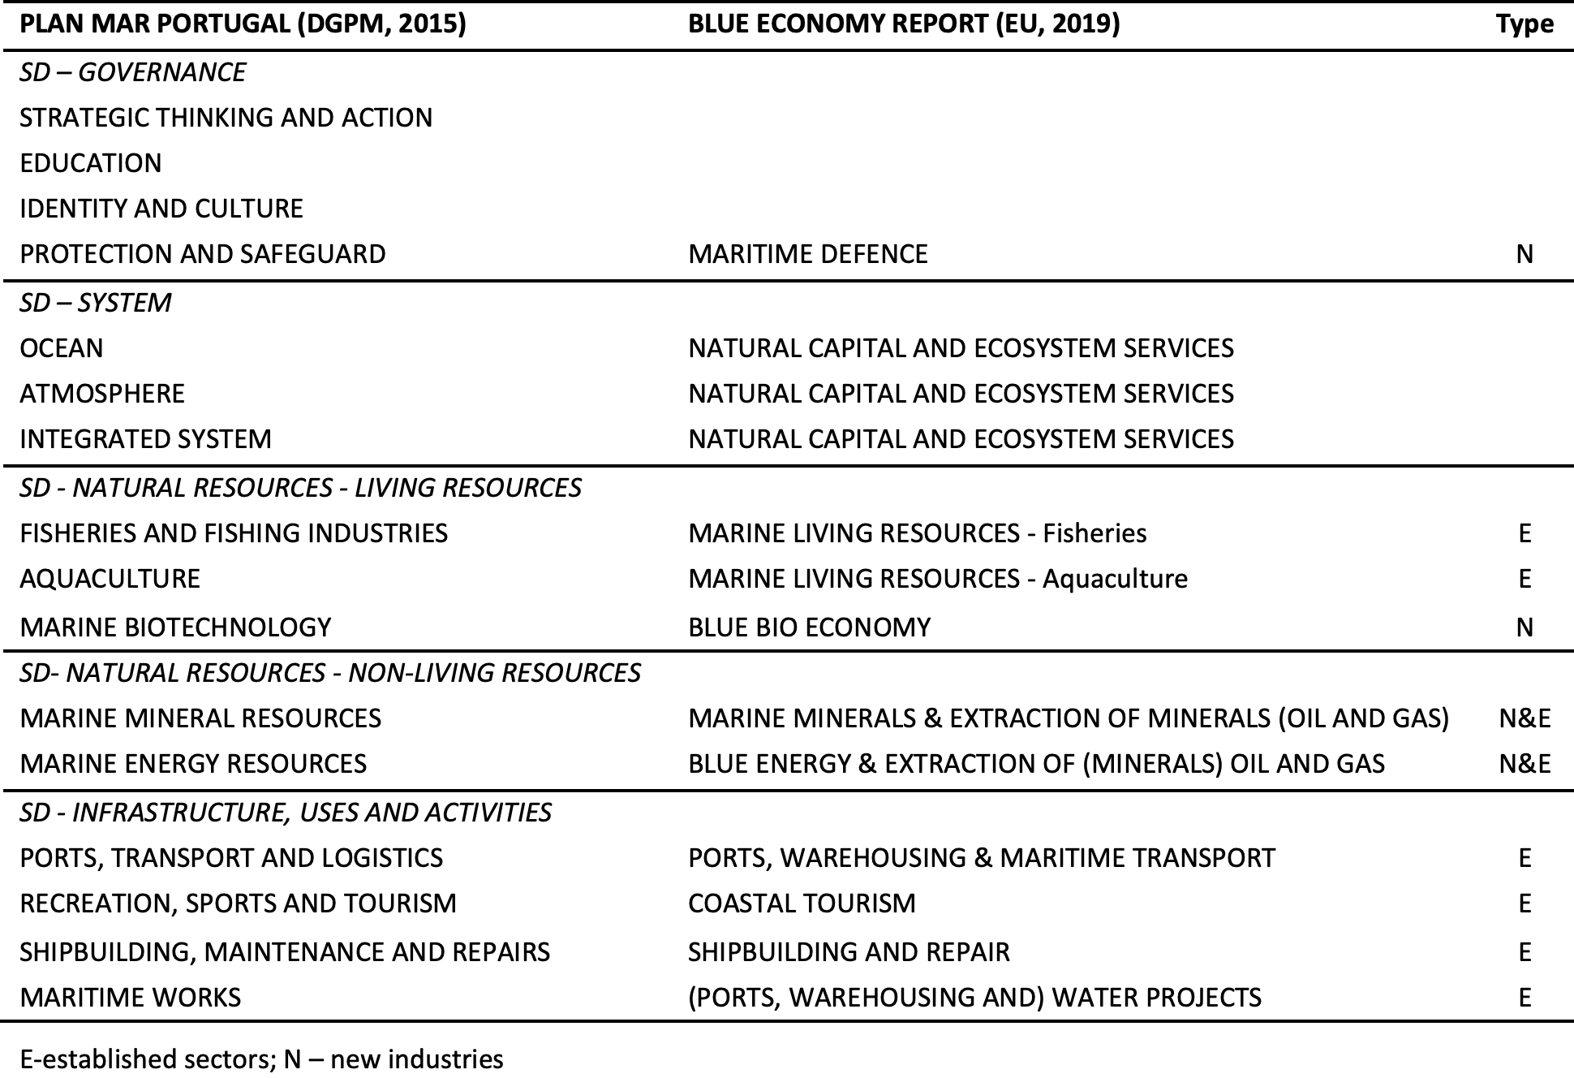
Comparing National and EU strategies

Slide 8
Data & Methods
The paper focuses on the research and technology development activities conducted by Portuguese organisations in the context of projects funded under the most recent European Framework Programme for Research and Innovation: the Horizon 2020.
FPs are a major EU policy instrument, stimulating research organisations, government agencies and industrial partners to cooperate in R&D projects and generating knowledge that spans across national borders (Amoroso, et al, 2018). They are pivotal for transforming informal nation-based research networks into formal collaboration arrangements at European level (Heller-Schuh et al, 2011).

Slide 9
The research is based on all the projects with Portuguese participation funded since the beginning of the Programme (2014) until the end of 2018, extracted from the CORDIS database.
For the 136 projects identified, information was collected: Start and End date, Budget, EU contribution, Objective, Coordinator, Participants; Type of organization; Country.
The projects were classified according to their main area of activity, using the categories defined in the Portuguese Strategy and Action-Plan.
The Portuguese Participants were also object of an additional treatment. NTBFs were singled out and distinguished from the remaining companies.

Slide 10
These collaborative projects were translated into inter-organizational networks. Symmetric adjacency matrices were built, valued by the number of common projects.
To map the partnerships we used social network diagrams (Netdraw).

Slide 11
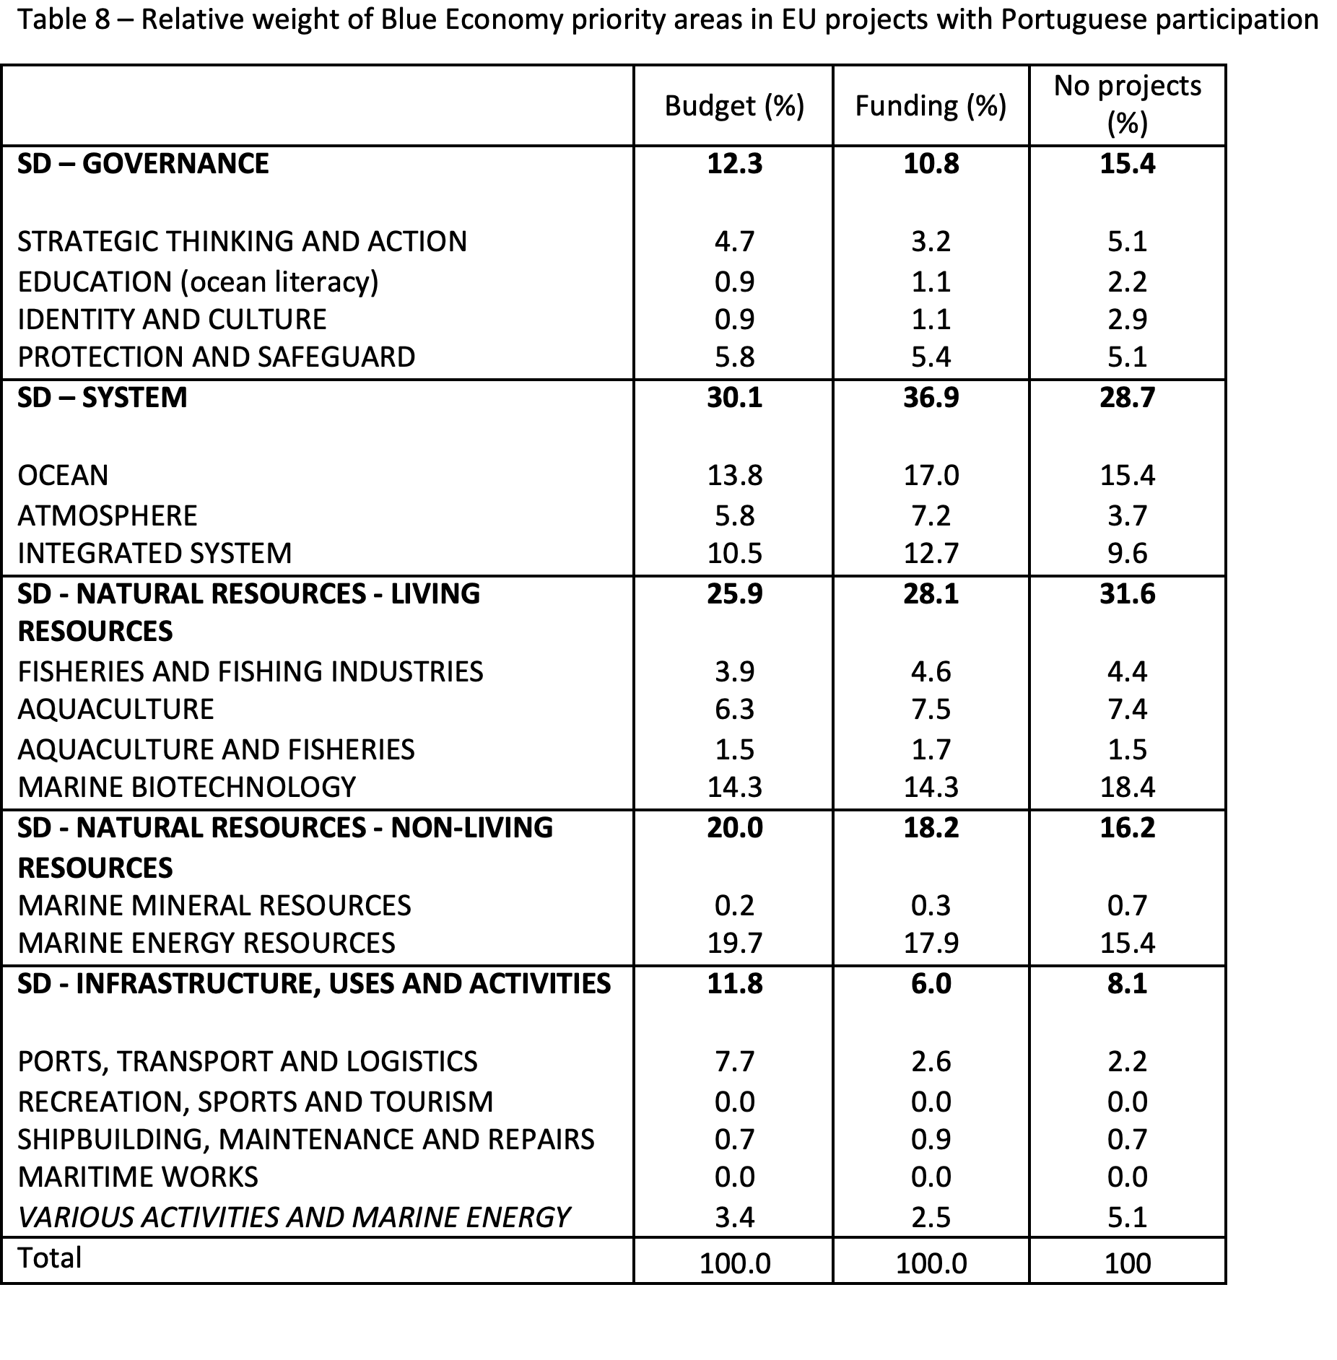
Results
The priority areas

Slide 12
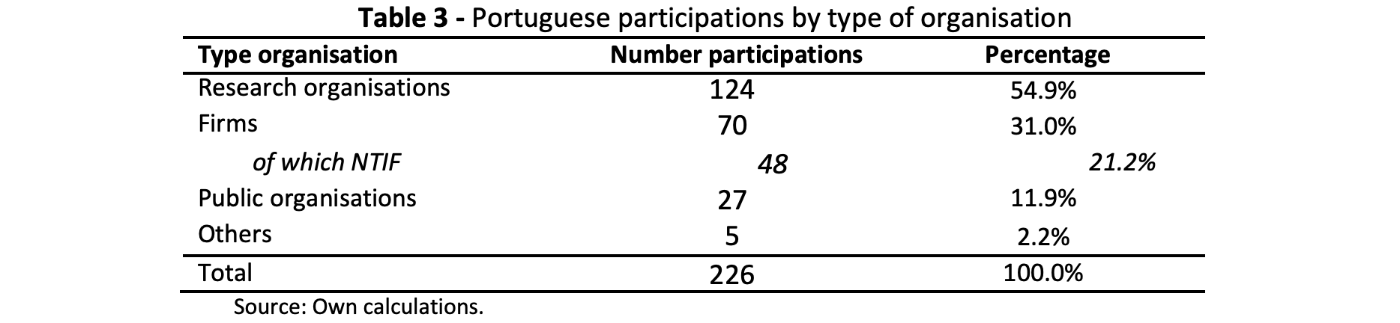
The position of different actors

Slide 13
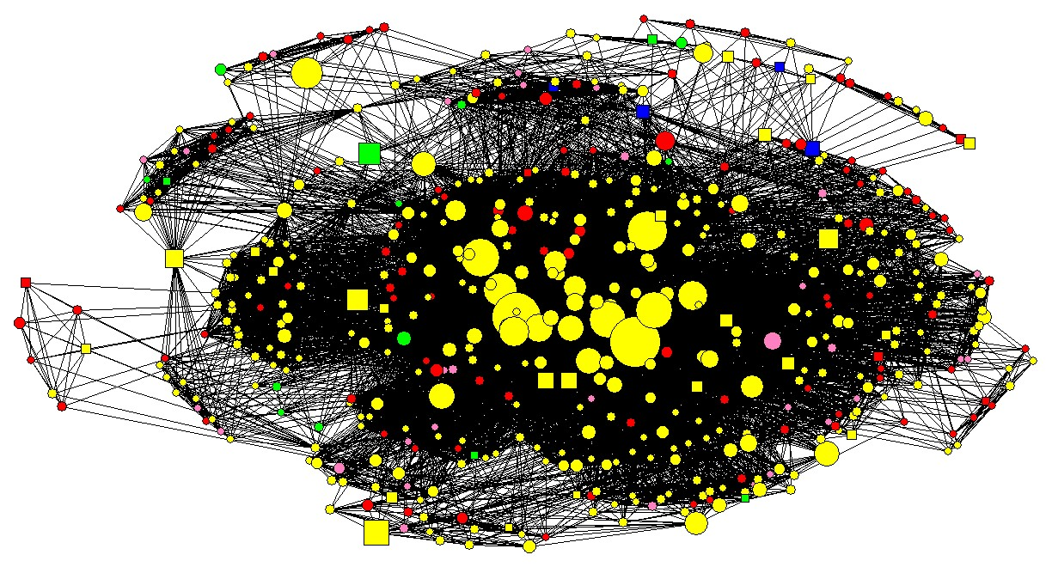
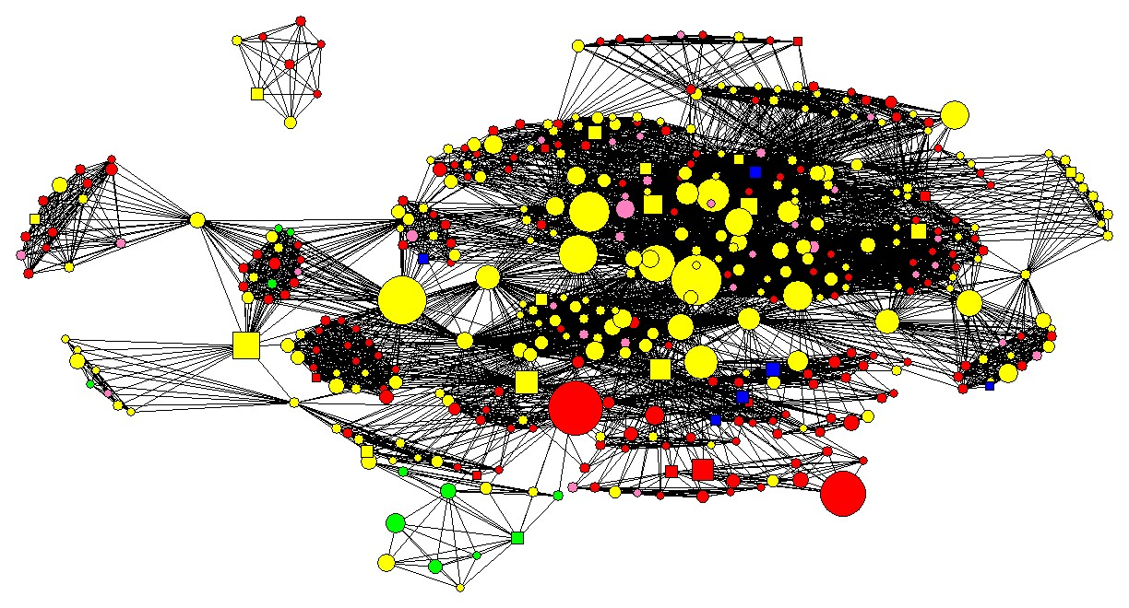
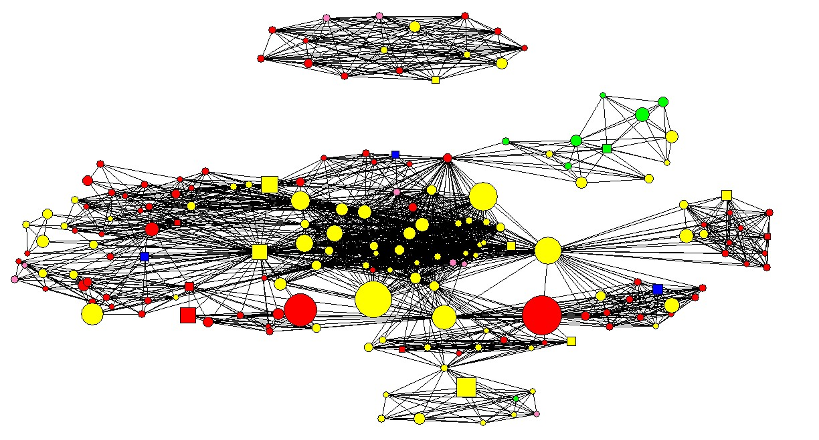
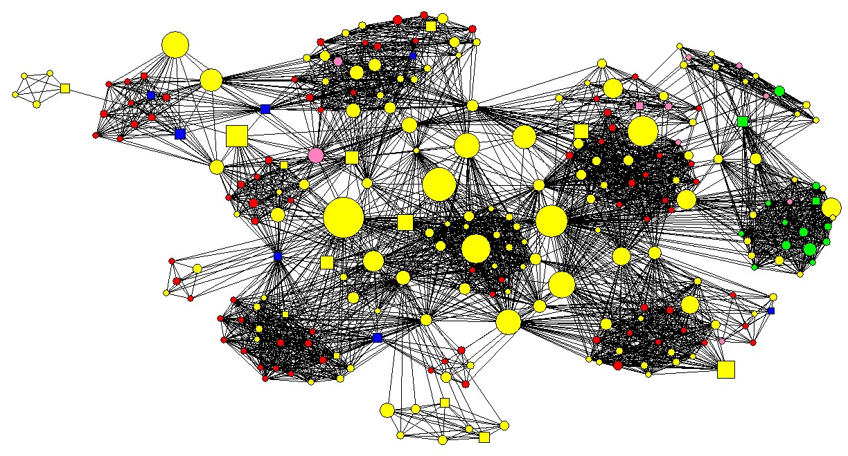
Living Resources Fisheries and Aquaculture areas
System domain
Non-Living Resources domain
Living Resources Marine Biotechnology area
Legend: Squares – Portuguese organisations; Circles – Foreign organisations;
Red – Firms; Blue – NTIFs; Yellow – Research Organisations; Green – Public Organisations; Pink – Other Organisations. The size of the node is proportional to the EU funding received by the organisation.

Slide 14
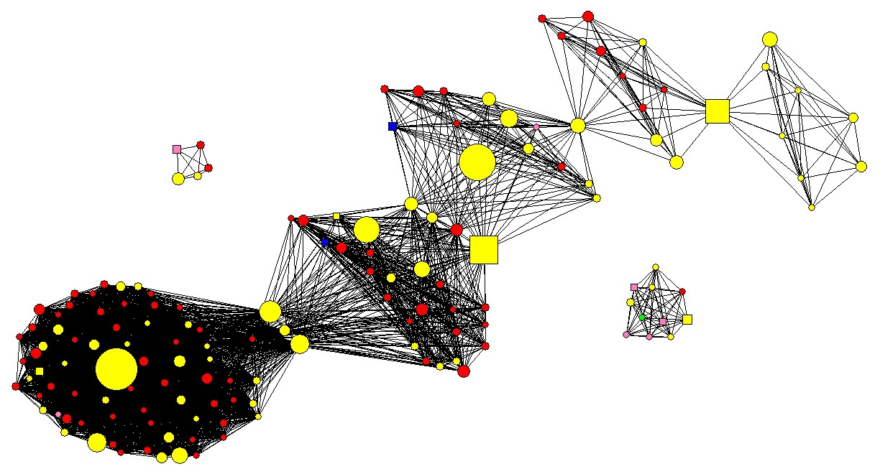
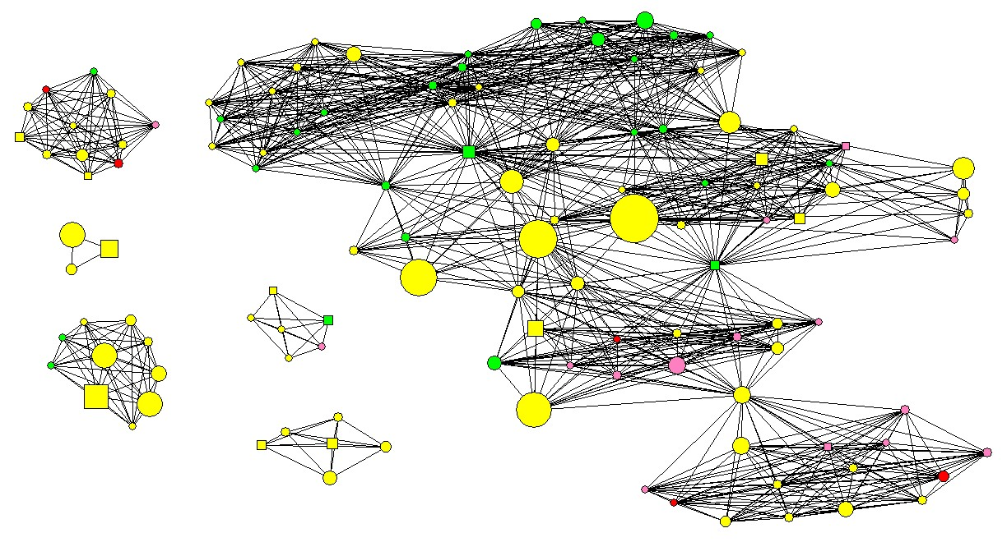
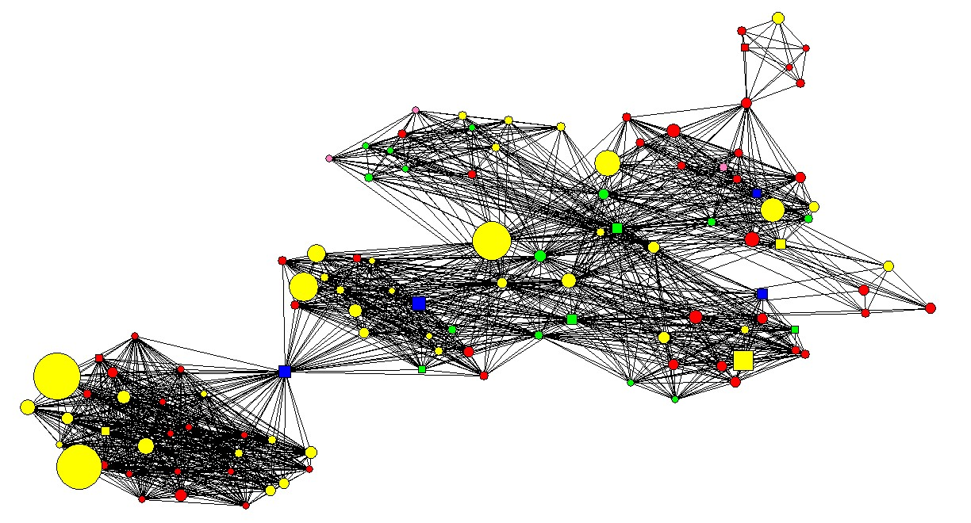
Infrastructure, Uses and Activities domain
Governance domain cultural areas
Governance domain Protection and Safeguard area
Legend: Squares – Portuguese organisations; Circles – Foreign organisations;
Red – Firms; Blue – NTIFs; Yellow – Research Organisations; Green – Public Organisations; Pink – Other Organisations. The size of the node is proportional to the EU funding received by the organisation.

Slide 15
Conclusions
Regarding the strategic areas the results show:
large investments, in particular by research organisations, in system structuring activities (marine resources and marine environment). This area was identified as underdeveloped by the national strategy, being a critical step in the sustainable exploitation of the ocean.
that research targeting industrial activity is concentrated in:
    exploitation of living resources: by revitalising established industries with a long tradition in the country - fish capture and transformation – namely through research in aquaculture; and by investing strongly in a new area – marine biotechnology – whose activities target a variety of application sectors (e.g. fisheries, health, cosmetics, environment).
    marine energies: by strengthening the investment made in marine renewable energies in the last decades.
the principal gaps appear to be the limited activities targeting other sea-related industries, and the absence of activity in the area of marine mineral resources.

Slide 16
Regarding the positioning of organizations, results show:
The central role of research organisations that not only dominate in more structural activities, but also are often part of mixed teams in more application-oriented projects.
The important role NTIFs - active in biotechnology, instrumentation, underwater robotics and materials - particularly in areas that require development of application oriented methods, products, services.
A similar role is played in some areas by a few other technology-oriented (established) companies, large firms or firms belonging to large groups.
These two types of firms are often part of mixed teams with research organisations and, in a few cases, also include established companies from user sectors.
The main actors in most projects, in terms of funding and participation, are foreign organisations: Portuguese organisations can also profit from the interaction with reputed foreign partners, namely in areas where new competence was being acquired.

Slide 17
Creating a Blue Economy:
Research and innovation partnerships to accelerate the development of ocean-related industries
Cristina Sousa, Oscarina Conceição & Margarida Fontes
This research was supported by a grant from FCT (PTDC/GES-OUT/30559/2017)

